Slide 1
Introduction to Reinforcement Learning
Part 10

Slide 2
Agenda
What is reinforcement learning
Distinctions from supervised learning
Examples
Basic solutions
Overview
Value iteration and Q-learning
Approximative Methods
Function approximation (Deep-Q Networks)
Policy gradient

Slide 3

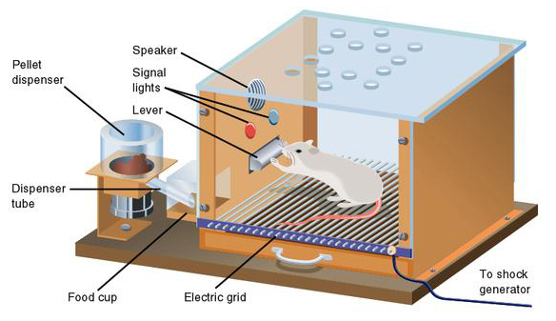

Inspiration from Behaviorist Psychology

Slide 4
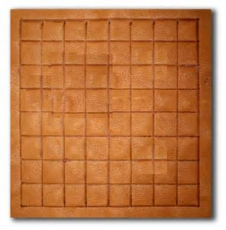
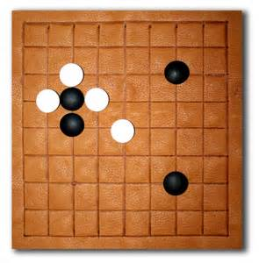
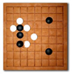
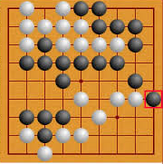
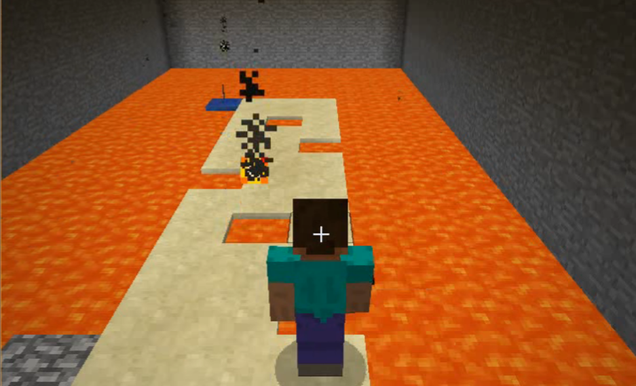
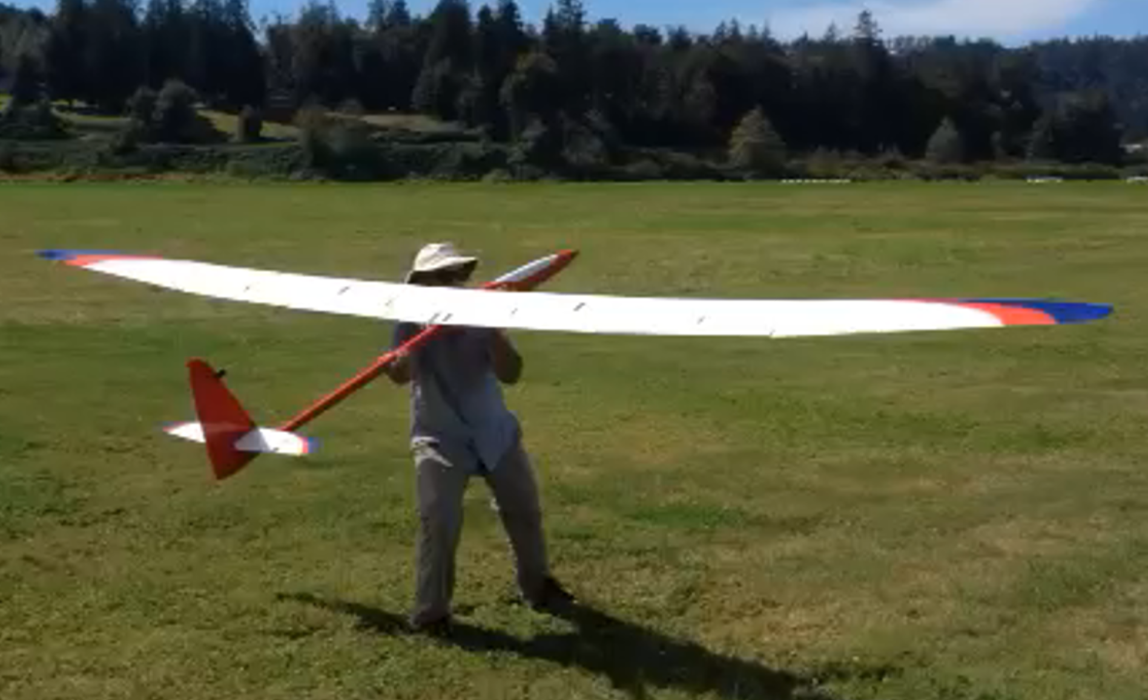



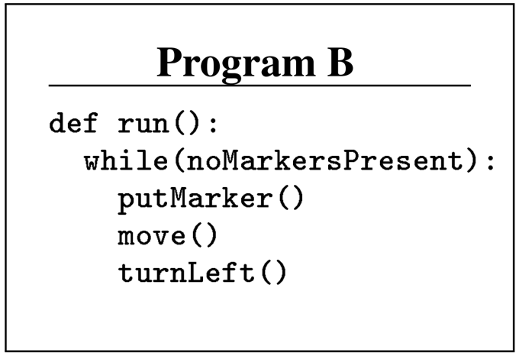
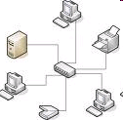
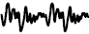
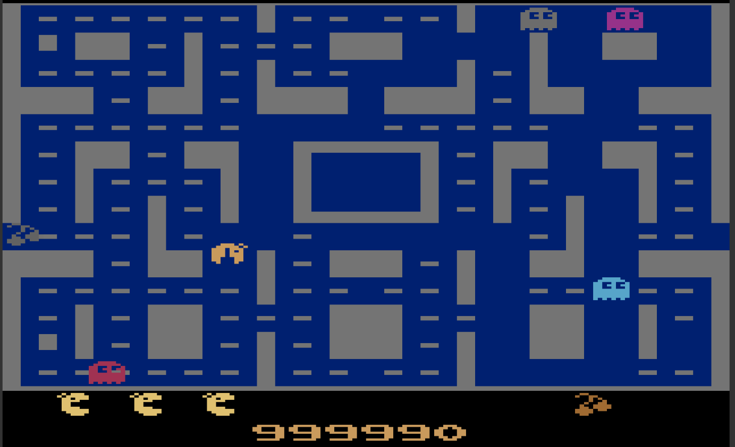
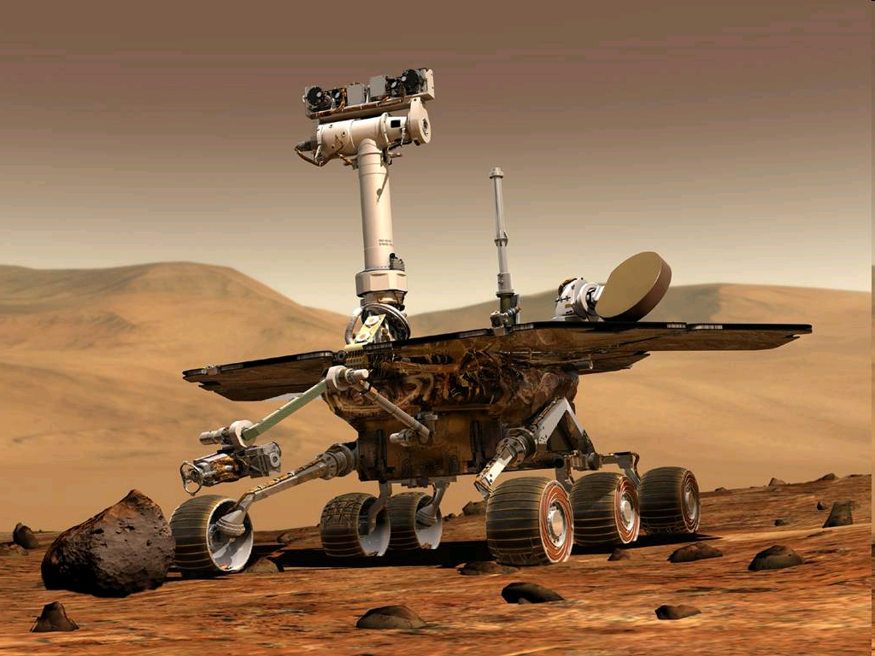
Sequential decision making as RL
Agent plays white
“state”
“next state”
“final state”
White wins
“action”
“reward” is +1
(-1 otherwise)
Program synthesis
Dialogue systems
Autonomic computing
News/ads
recommendation
Games
(Malmo, Ms. Pac-Man)
Robotics & control
More to be covered later today…

Slide 5
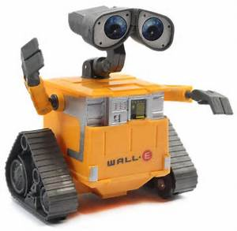

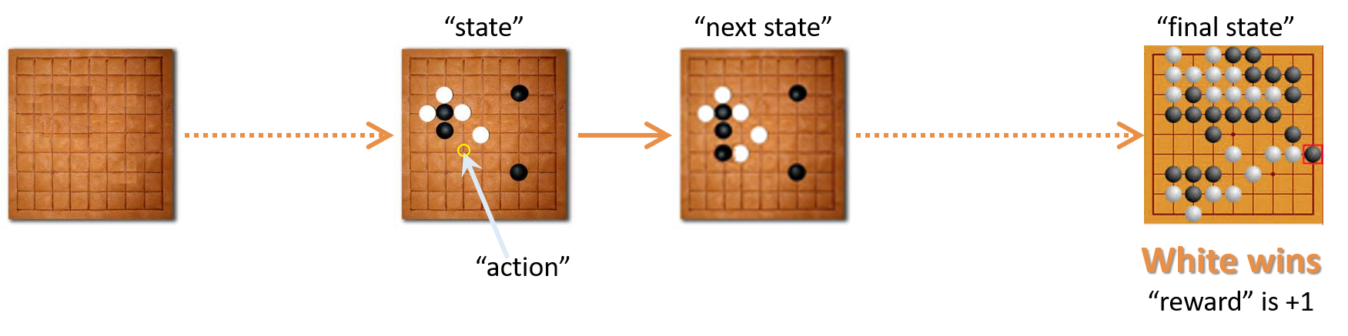
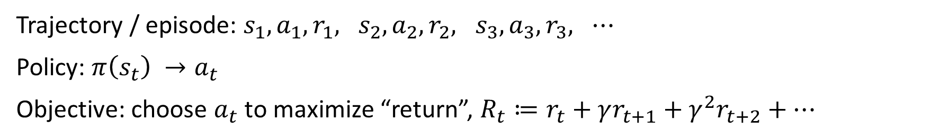
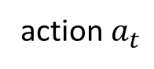
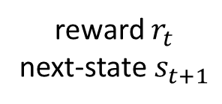
Problem statement
action $a_{t}$
RL
World
reward $r_{t}$
next-state $s_{t+1}$
Trajectory / episode: $s_{1},a_{1},{r_{1}, s}_{2},a_{2},{r_{2}, s}_{3},a_{3},r_{3}, ⋯$
Policy: $π\left(s_{t}\right) →a_{t}$
Objective: choose $a_{t}$ to maximize “return”, $R_{t}≔r_{t}+γr_{t+1}+γ^{2}r_{t+2}+⋯$

Slide 6

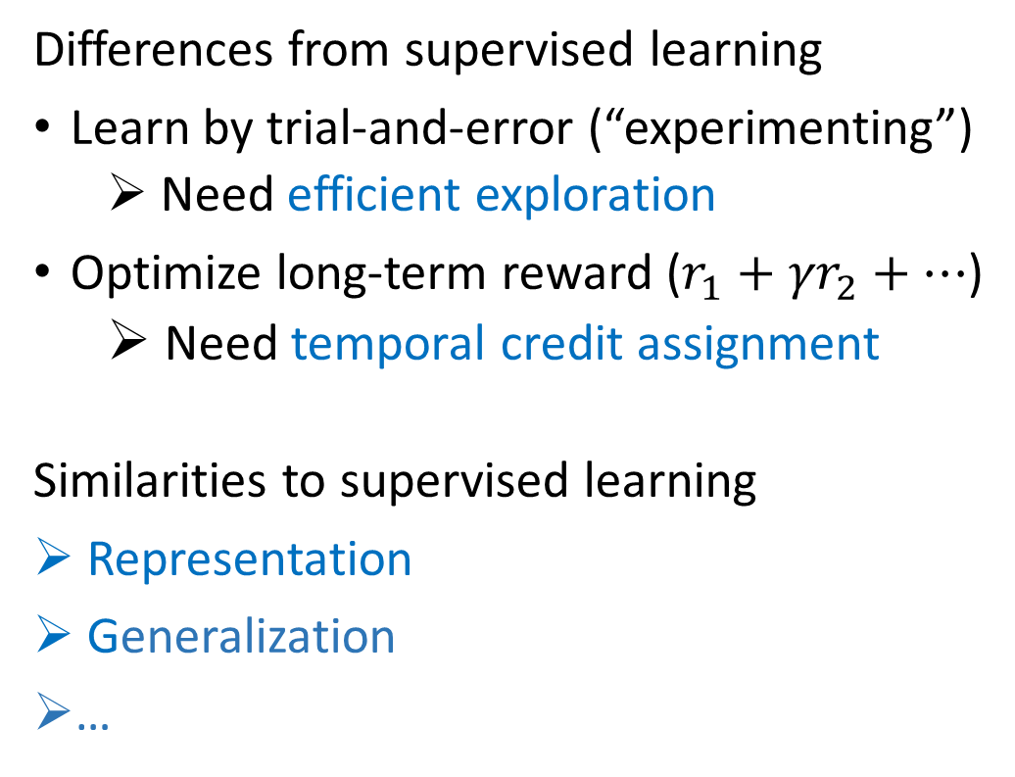
RL vs. SL (supervised learning)
Differences from supervised learning
Learn by trial-and-error (“experimenting”)
Need efficient exploration
Optimize long-term reward ($r_{1}+{γr}_{2}+…$)
Need temporal credit assignment
Similarities to supervised learning
Representation
Generalization
…
action
RL
reward &
next-state
world
input/feature
SL
true label
teacher
Notes:
The fundamental distinction between RL and SL is that an RL agent does not have a teacher to learn from. It leads to two main differences: (1) need for exploration and (2) temporal credit assignment.

Slide 7

RL or SL?

Slide 8

Driverless Car
Problem: build a self-driving car
Reinforcement learning
Credit: caradisiac.com
Notes:
State/observation: road condition around the card, current speed and acceleration, …
Action: break, speed, wheel turns, …
Reward: positive reward per mile of safe driving, and negative BIG reward if accident happens

Slide 9





Email Spam
Your favorite
ML algorithm
Supervised learning
Problem: detect whether an email is spam or not.
Labeled training data
Notes:
Typically treated as supervised learning, where labeled training data are collected and used to train a classifier.
There is, however, a simplification above, where we assume the spammer is lazy and does not change her spam generator. In practice, spammers do adapt their spam emails to try to fool existing spam detectors. Therefore, it is usually supervised learning with periodic re-training.

Slide 10








Web Content Recommendation
Current user
All users
Reinforcement learning
(a special kind known as contextual bandit)
Problem: personalized recommendation to maximize #clicks
Notes:
State: user information (browsing history, age, gender, location, etc.)
Action: which advertisement/article to show.
Reward: 1 if click, and 0 if no-click.

Slide 11

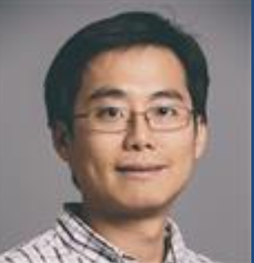
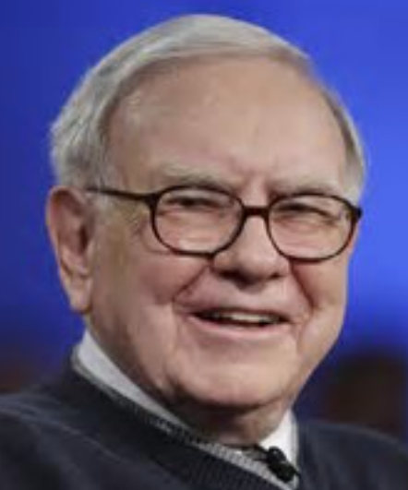
Stock trading
Supervised learning
Reinforcement learning
Problem: buy/sell stocks to maximize profit
Notes:
For small traders, it is easier to formulate the problem as supervised learning, where labels can be automatically generated from historical stock market data. For heavy traders, their buy/sell operations can have a significant impact on the market, so it becomes an RL problem.
If it’s formulated as RL:
State: all available information about market, individual firms, and politics
Action: buy or sell a certain stock. (This is to simplify the scenario, but in practice we need to consider combinations and amounts of stock to trade.)
Reward: gain in every day

Slide 12
More RL Examples
Application | Action | Observation | State | Reward
Playing Go (board game) | Where to place a stone | Configuration of board | Configuration of board | Win game: +1 Else: -1
Playing Atari (video games) | Joystick and button inputs | Screen at time t | Screen at times t, t-1, t-2, t-3 | Game score increment
Direct mail marketing | Whether to mail a customer a catalog | Whether customer makes a purchase | History of purchases and mailings | $ profit from purchase (if any) - $ cost of mailing catalog
Conversational system | What to say to the user, or API action to invoke | What user says, or what API returns | History of the conversation; state of the back-end | Task success: +10 Task fail: -20 Else: -1

Slide 13
Problem statement (summary)
RL is a class of problems, not a specific solution
RL is about learning to act optimally, without teacher supervision
In general, RL problems:
Have a stateful environment, where states are affected by agent’s actions
Need trial-and-error learning, not by imitating a teacher
Have delayed rewards, where an action’s value is not immediately clear

Slide 14
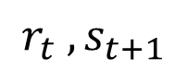
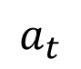
Simplified RL Problems
$$a_{t}$$
Contextual bandits
States are history independent:
No need for temporal credit assignment
Still needs efficient exploration
Applications: advertising, news recommendation, Web search, …
Imitation learning
RL with a teacher
Accelerates learning
RL
World
$${r_{t} , s}_{t+1}$$

Slide 15


Supervised Learning (SL) vs. Reinforcement Learning (RL)
Use Modes of RL
Define reward, if not obvious
Optimize policy by interaction with target environment
RL
Obtain access to the target environment
RL’
Create a simulation of the environment
Define reward, if not obvious
Optimize policy by interaction with simulated environment
RL’’
Collect a corpus of interactions with the environment
Corpus of interactions
Define reward, if not obvious
Optimize policy on the corpus
[Slide from Jason Williams]

Slide 16
Agenda
What is reinforcement learning
Distinctions from supervised learning
Examples
Basic solutions
Overview
Value iteration and Q-learning
Approximative Methods
Function approximation (Deep-Q Networks)
Policy gradient

Slide 17
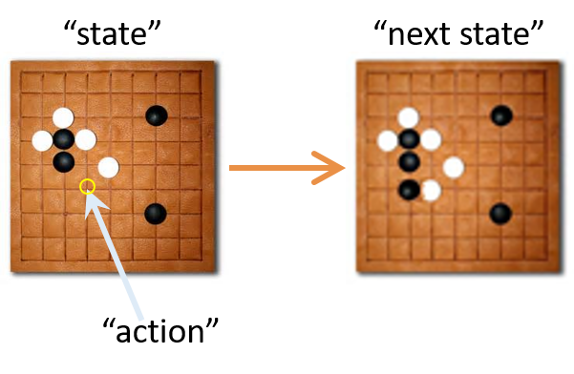
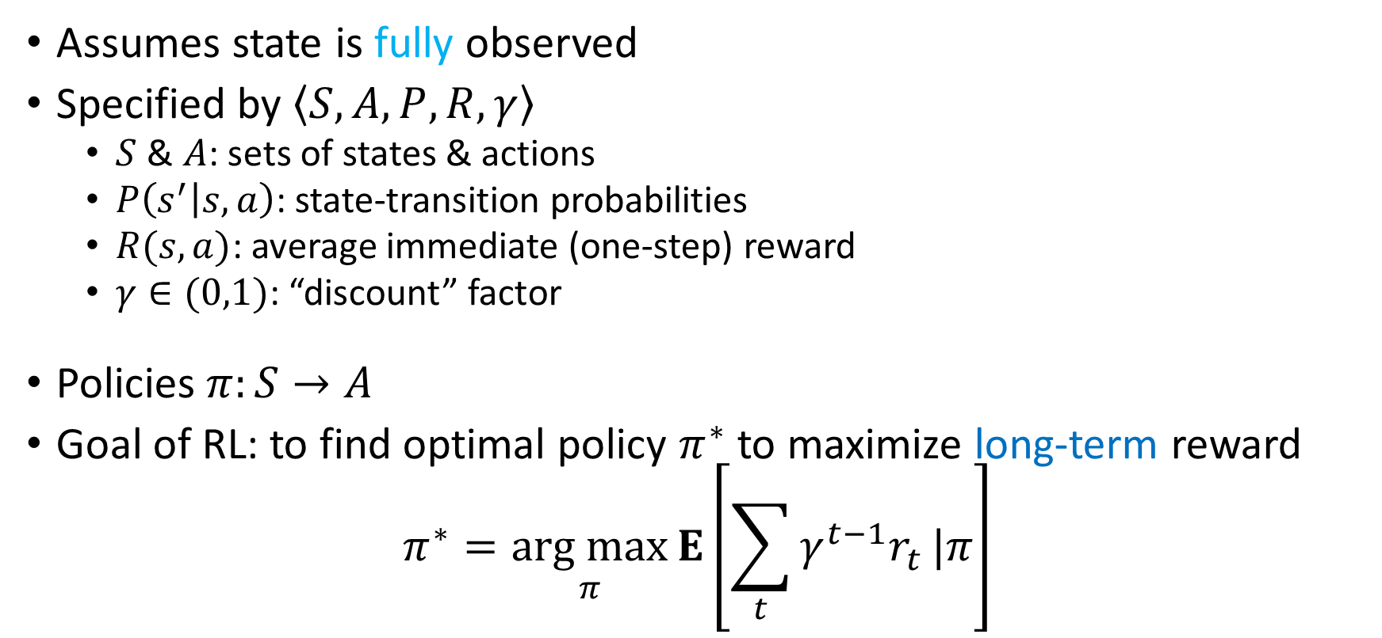
Markov decision process (MDP)
Assumes state is fully observed
Specified by $〈S,A,P,R,γ〉$
$S$ & $A$: sets of states & actions
$P\left(s^{′} | s,a\right)$: state-transition probabilities
$R(s,a)$: average immediate (one-step) reward
$γ∈(0,1)$: “discount” factor
Policies $π:S→A$
Goal of RL: to find optimal policy $π^{∗}$ to maximize long-term reward
$$π^{∗}=\underset{π}{arg max}{E\left[\sum_{t}{γ^{t−1}r_{t}}|π\right]}$$
Usually unknown in RL
Notes:
E is expectation
Note that E(x)=Sum(p(x)x)

Slide 18

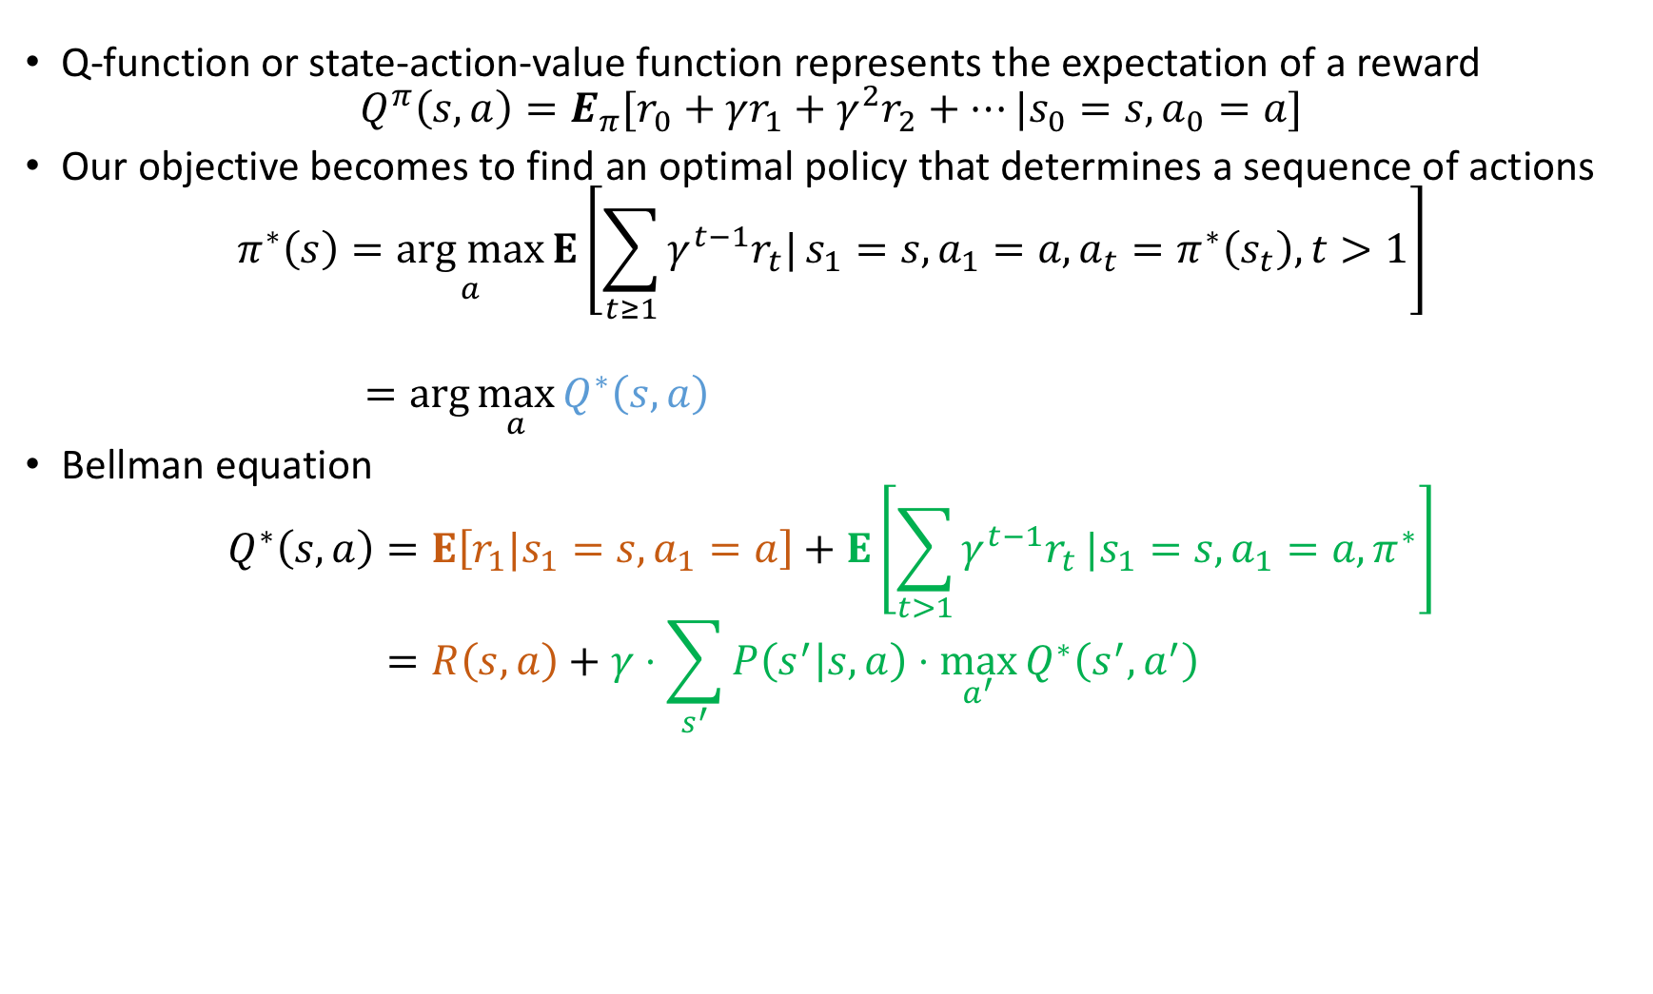
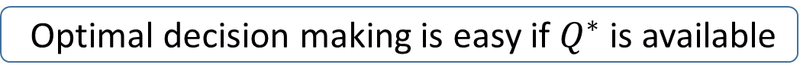
Principles of dynamic programming
Q-function or state-action-value function represents the expectation of a reward
$$Q^{π}\left(s,a\right)=E_{π}[r_{0}+γr_{1}+γ^{2}r_{2}+…|s_{0}=s, a_{0}=a]$$
Our objective becomes to find an optimal policy that determines a sequence of actions
$$π^{∗}\left(s\right)=\underset{a}{arg max}{E\left[\sum_{t≥1}{γ^{t−1}r_{t}|}s_{1}=s,a_{1}=a,a_{t}=π^{∗}\left(s_{t}\right), t>1\right]}$$
$$=\arg{\max_{a}{Q^{∗}\left(s,a\right)} }$$
Bellman equation
$$Q^{∗}\left(s,a\right)=E\left[r_{1}|s_{1}=s,a_{1}=a\right]+E\left[\sum_{t>1}{γ^{t−1}r_{t}}|s_{1}=s,a_{1}=a,π^{∗}\right]$$
$$=R\left(s,a\right)+γ⋅\sum_{s^{′}}{P\left(s^{′} | s,a\right)⋅\max_{a^{′}}}Q^{∗}\left(s^{′},a^{′}\right)$$
Optimal decision making is easy if $Q^{∗}$ is available
Immediate
reward
Expected maximum future reward

Slide 19
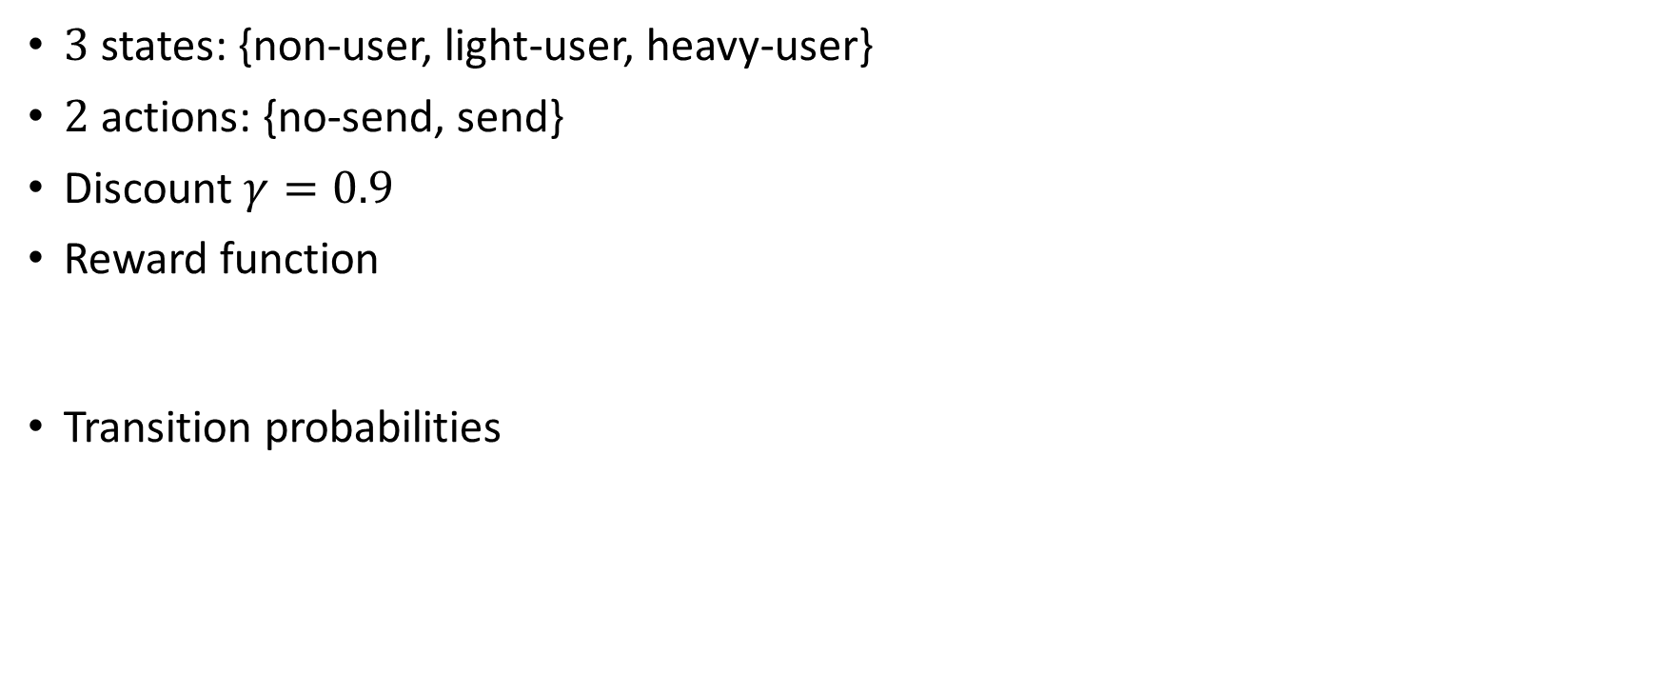


MDP example: Direct mail campaign (much simplified)
$3$ states: {non-user, light-user, heavy-user}
$2$ actions: {no-send, send}
Discount $γ=0.9$
Reward function
Transition probabilities
Monthly spent = 0
Monthly spent $<$ 200
Monthly spent $≥$ 200
 | Non-user | Light-user | Heavy-user
No-send | $ 0 | $ 20 | $ 100
Send | $ (-1) | $ 15 | $ 80
$$\operatorname{Pr}\left(s_{t+1}=\text{heavy} | s_{t}=\text{light},a_{t}=\text{no}\text{−}\text{send}\right)$$
 | Non | Light | Heavy
Non | 0.95 | 0.05 | 0.0
Light | 0.2 | 0.75 | 0.05
Heavy | 0.1 | 0.2 | 0.7
 | Non | Light | Heavy
Non | 0.1 | 0.85 | 0.05
Light | 0.1 | 0.2 | 0.7
Heavy | 0.05 | 0.15 | 0.8
For action “no-send”
For action “send”

Slide 20
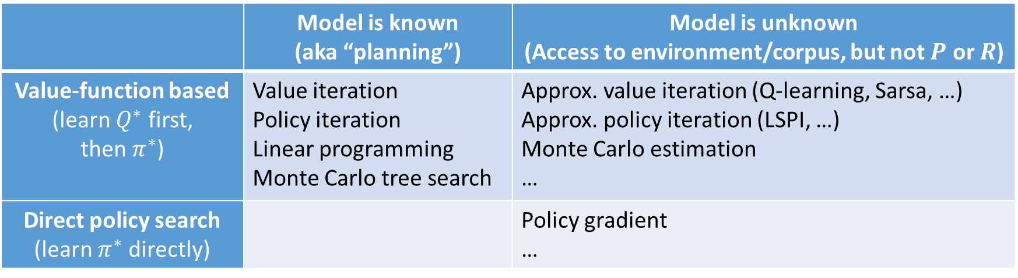
RL algorithms: A simplified overview
 | Model is known (aka “planning”) | Model is unknown (Access to environment/corpus, but not $P$ or $R$)
Value-function based (learn $Q^{∗}$ first, then $π^{∗}$) | Value iteration Policy iteration Linear programming Monte Carlo tree search | Approx. value iteration (Q-learning, Sarsa, …) Approx. policy iteration (LSPI, …) Monte Carlo estimation …
Direct policy search (learn $π^{∗}$ directly) |  | Policy gradient …
Not covered: model-based RL, actor-critic, exploration , reward shaping, off-policy RL
hierarchical problem solving, transfer/multi-task RL, multi-agent RL, …
Representation?

Slide 21
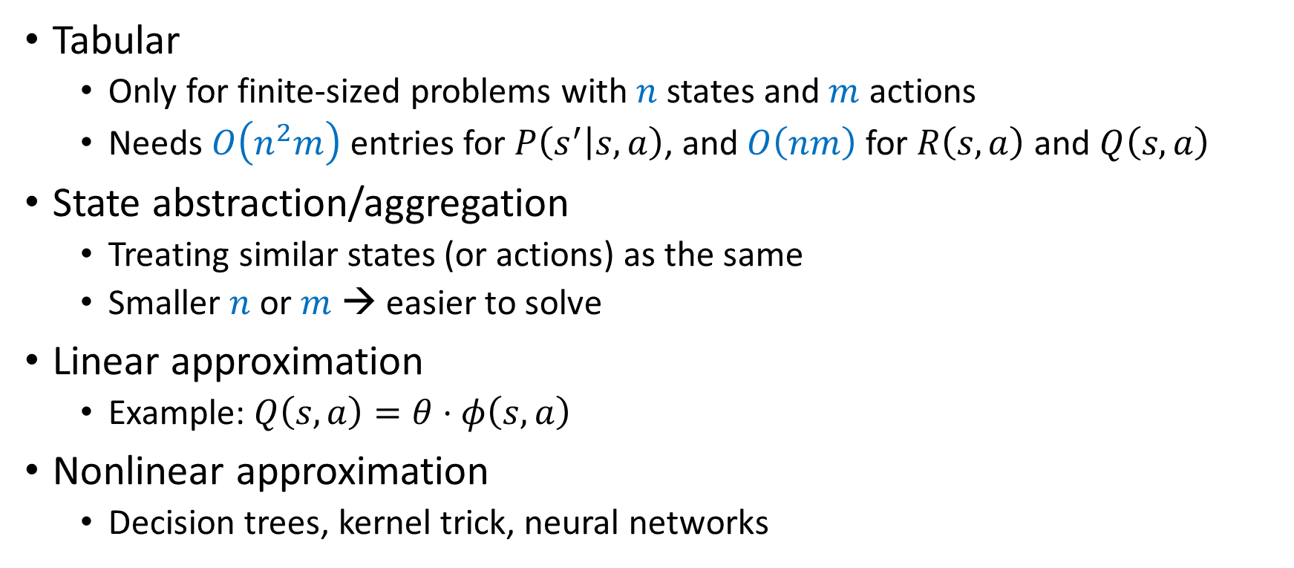
Representations in RL
Tabular
Only for finite-sized problems with $n$ states and $m$ actions
Needs $O\left(n^{2}m\right)$ entries for $P\left(s^{′} | s,a\right)$, and $O\left(nm\right)$ for $R\left(s,a\right)$ and $Q\left(s,a\right)$
State abstraction/aggregation
Treating similar states (or actions) as the same
Smaller $n$ or $m$ → easier to solve
Linear approximation
Example: $Q\left(s,a\right)=θ⋅φ\left(s,a\right)$
Nonlinear approximation
Decision trees, kernel trick, neural networks

Slide 22
RL algorithms: A simplified overview
 | Model is known (aka “planning”) | Model is unknown (Access to environment/corpus, but not $P$ or $R$)
Value-function based (learn $Q^{∗}$ first, then $π^{∗}$) | Value iteration Policy iteration Linear programming Monte Carlo tree search | Approx. value iteration (Q-learning, Sarsa, …) Approx. policy iteration (LSPI, …) Monte Carlo estimation …
Direct policy search (learn $π^{∗}$ directly) |  | Policy gradient …
Value iteration
Q-learning
Policy gradient
Not covered: model-based RL, actor-critic, exploration , reward shaping, off-policy RL
hierarchical problem solving, transfer/multi-task RL, multi-agent RL, …
Representation
Tabular
State abstraction/aggregation
Linear approximation
Nonlinear approximation
“deep RL”

Slide 23
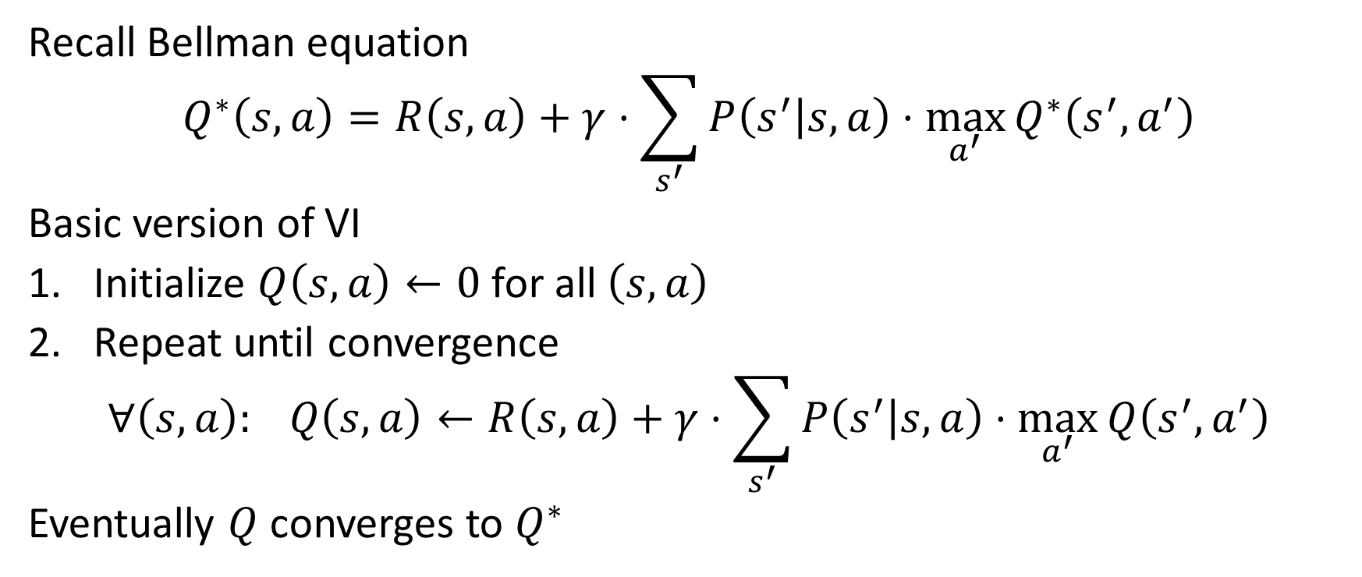
Value iteration: Tabular case
Recall Bellman equation
$$Q^{∗}\left(s,a\right)=R\left(s,a\right)+γ⋅\sum_{s^{′}}{P\left(s^{′} | s,a\right)⋅\max_{a^{′}}}Q^{∗}\left(s^{′},a^{′}\right)$$
Basic version of VI
Initialize $Q\left(s,a\right)←0$ for all $\left(s,a\right)$
Repeat until convergence
$$∀\left(s,a\right): Q\left(s,a\right)←R\left(s,a\right)+γ⋅\sum_{s^{′}}{P\left(s^{′} | s,a\right)⋅\max_{a^{′}}{Q\left(s^{′},a^{′}\right)}}$$
Eventually $Q$ converges to $Q^{∗}$

Slide 24
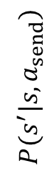
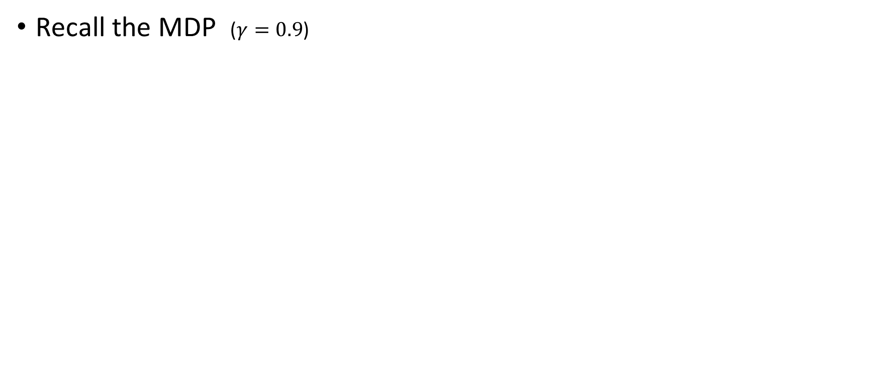
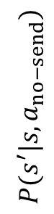
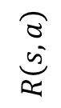
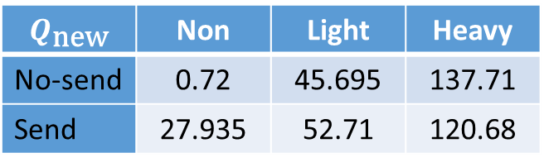
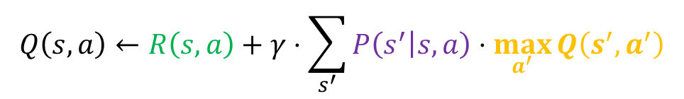
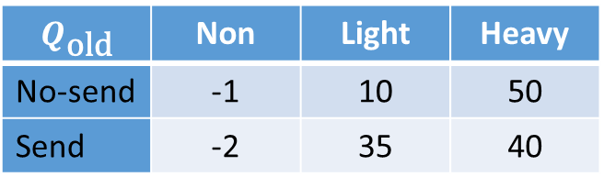
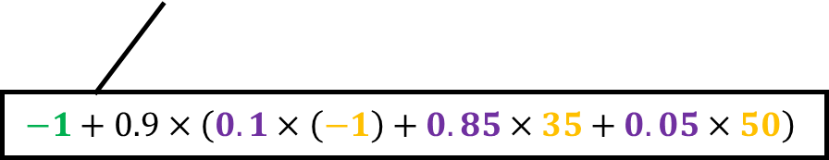
Value iteration in mail campaign example
$$Q\left(s,a\right)←R\left(s,a\right)+γ⋅\sum_{s^{′}}{P\left(s^{′} | s,a\right)⋅\max_{a^{′}}{Q\left(s^{′},a^{′}\right)}}$$
Recall the MDP ($γ=0.9$)
 | Non | Light | Heavy
No-send | $ 0 | $ 20 | $ 100
Send | $ (-1) | $ 15 | $ 80
$$R\left(s,a\right)$$
$$Q_{\text{old}}$$ | Non | Light | Heavy
No-send | -1 | 10 | 50
Send | -2 | 35 | 40
$$P(s^{′}|s,a_{no−send})$$
 | Non | Light | Heavy
Non | 0.95 | 0.05 | 0.0
Light | 0.2 | 0.75 | 0.05
Heavy | 0.1 | 0.2 | 0.7
After 1 iteration
$$Q_{\text{new}}$$ | Non | Light | Heavy
No-send | 0.72 | 45.695 | 137.71
Send | 27.935 | 52.71 | 120.68
$$P(s^{′}|s,a_{send})$$
 | Non | Light | Heavy
Non | 0.1 | 0.85 | 0.05
Light | 0.1 | 0.2 | 0.7
Heavy | 0.05 | 0.15 | 0.8
$$−1+0.9×\left(0.1×\left(−1\right)+0.85×35+0.05×50\right)$$

Slide 25
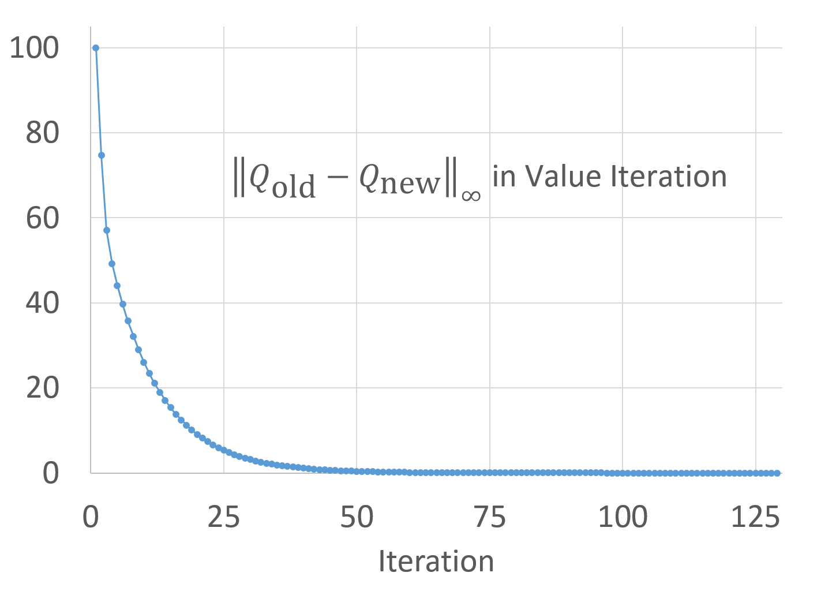
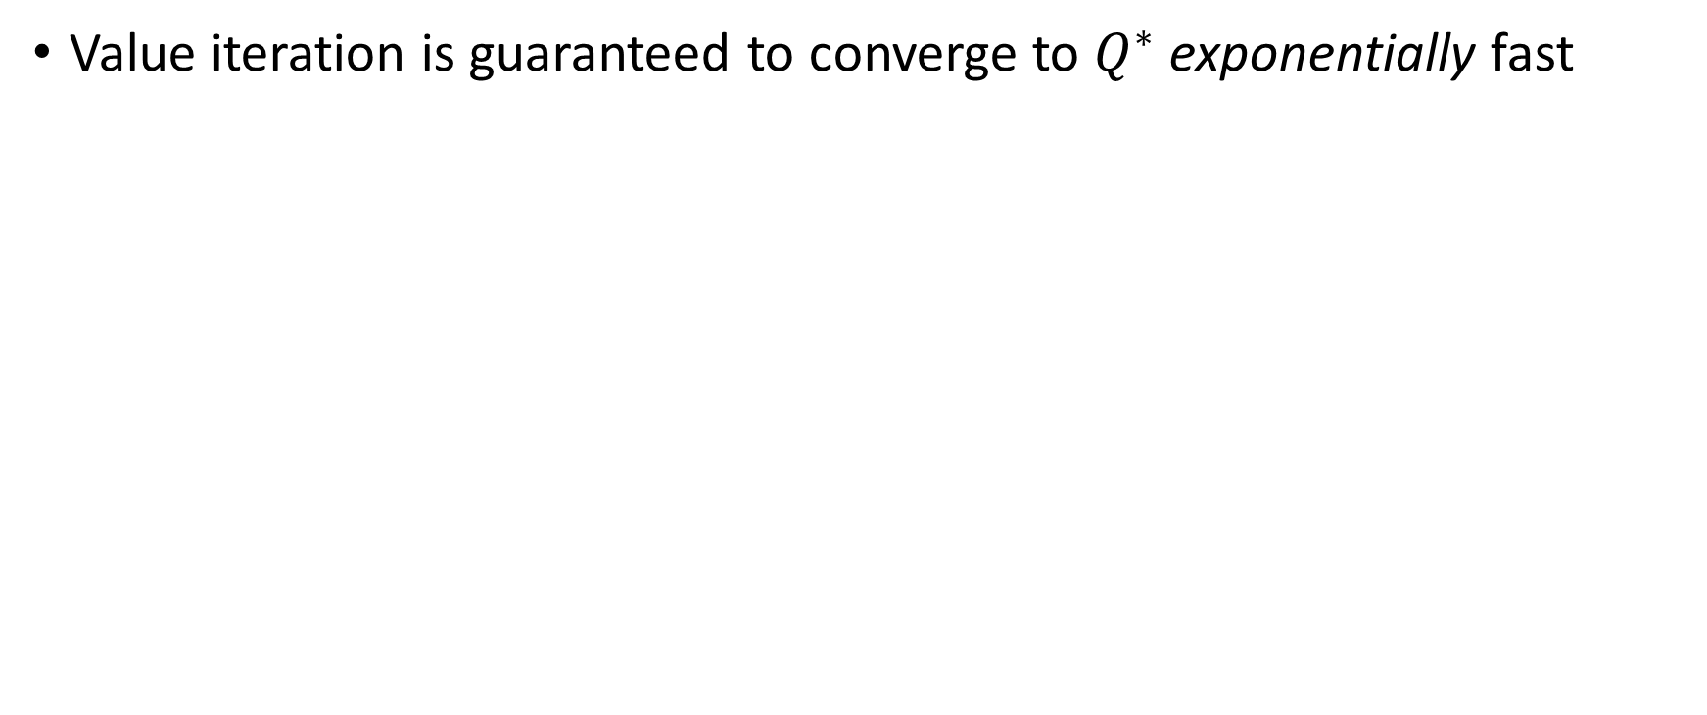
Value iteration in mail campaign example (cont’d)
Value iteration is guaranteed to converge to $Q^{∗}$ exponentially fast

Slide 26
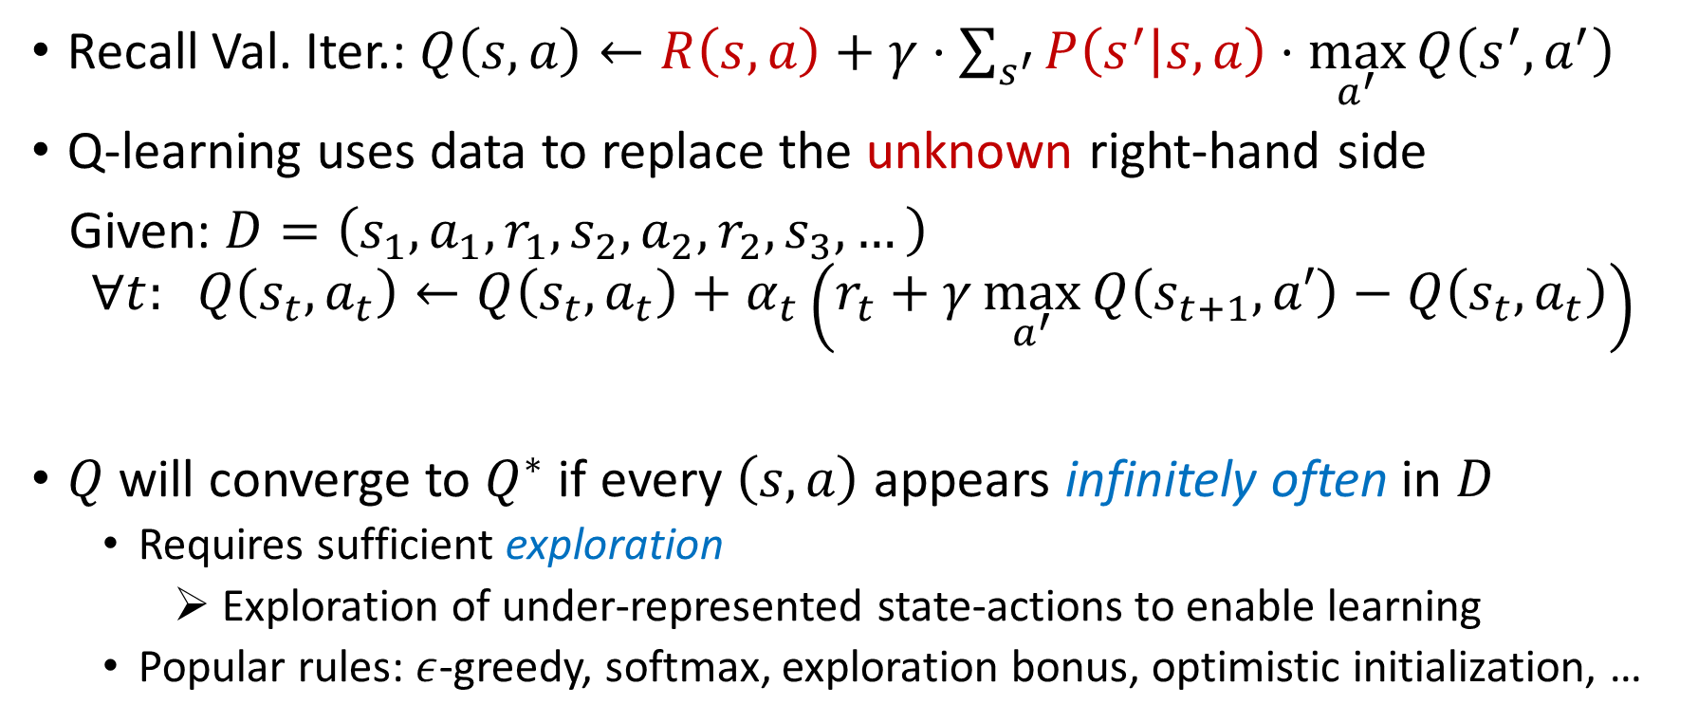

Q-learning: Tabular case, Temporal Difference
Recall Val. Iter.: $Q\left(s,a\right)←R\left(s,a\right)+γ⋅\sum_{s^{′}}{P\left(s^{′} | s,a\right)⋅\max_{a^{′}}{Q\left(s^{′},a^{′}\right)}}$
Q-learning uses data to replace the unknown right-hand side
Given: $D=\left(s_{1},a_{1},r_{1},s_{2},a_{2},r_{2},s_{3},…\right)$
$$∀t: Q\left(s_{t},a_{t}\right)←Q\left(s_{t},a_{t}\right)+α_{t}\left(r_{t}+γ\max_{a^{′}}{Q\left(s_{t+1},a′\right)}−Q\left(s_{t},a_{t}\right)\right)$$
$Q$ will converge to $Q^{∗}$ if every $\left(s,a\right)$ appears infinitely often in $D$
Requires sufficient exploration
Exploration of under-represented state-actions to enable learning
Popular rules: $ε$-greedy, softmax, exploration bonus, optimistic initialization, …
$$≈$$
“learning rate”
“temporal difference”

Slide 27
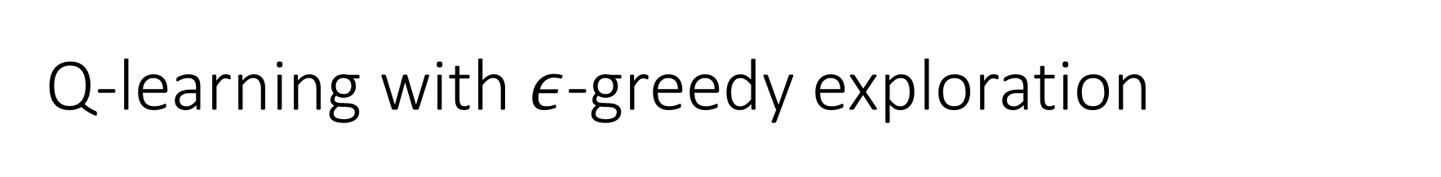
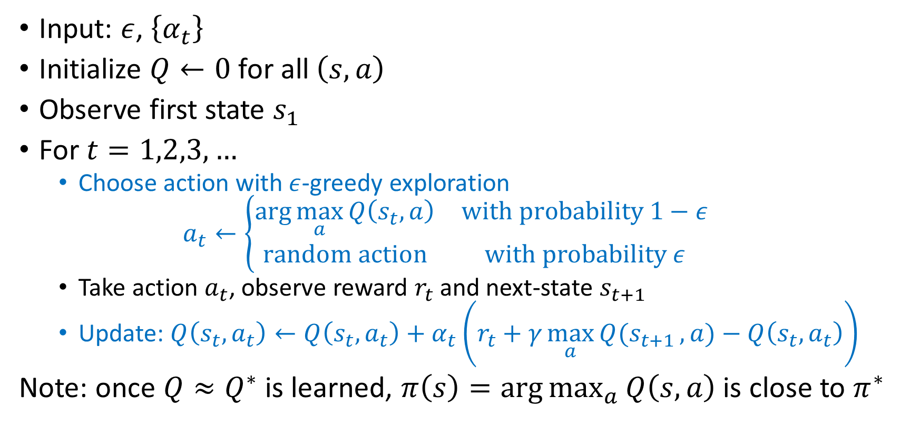
Q-learning with $ε$-greedy exploration
Input: $ε$, $\left\{α_{t}\right\}$
Initialize $Q←0$ for all $\left(s,a\right)$
Observe first state $s_{1}$
For $t=1,2,3,…$
Choose action with $ε$-greedy exploration
$$a_{t}←\left\{\begin{matrix}\arg{\max_{a}{Q\left(s_{t},a\right)}} & \text{with} \text{probability} 1−ε \\ \text{random} \text{action} & \text{with} \text{probability} ε\end{matrix}\right.$$
Take action $a_{t}$, observe reward $r_{t}$ and next-state $s_{t+1}$
Update: $Q\left(s_{t},a_{t}\right)←Q\left(s_{t},a_{t}\right)+α_{t}\left(r_{t}+γ\max_{a}{Q(s_{t+1}},a)−Q\left(s_{t},a_{t}\right)\right)$
Note: once $Q≈Q^{∗}$ is learned, $π\left(s\right)=\arg{\max_{a}{Q\left(s,a\right)}}$ is close to $π^{∗}$
Notes:
Q-learning is one of the value-function-based methods, which first learn the value function, and then use it to derive a policy. The second step, policy derivation, is often easy, involving taking a max over all actions in the current state --- see the note in the last line of the slide.

Slide 28
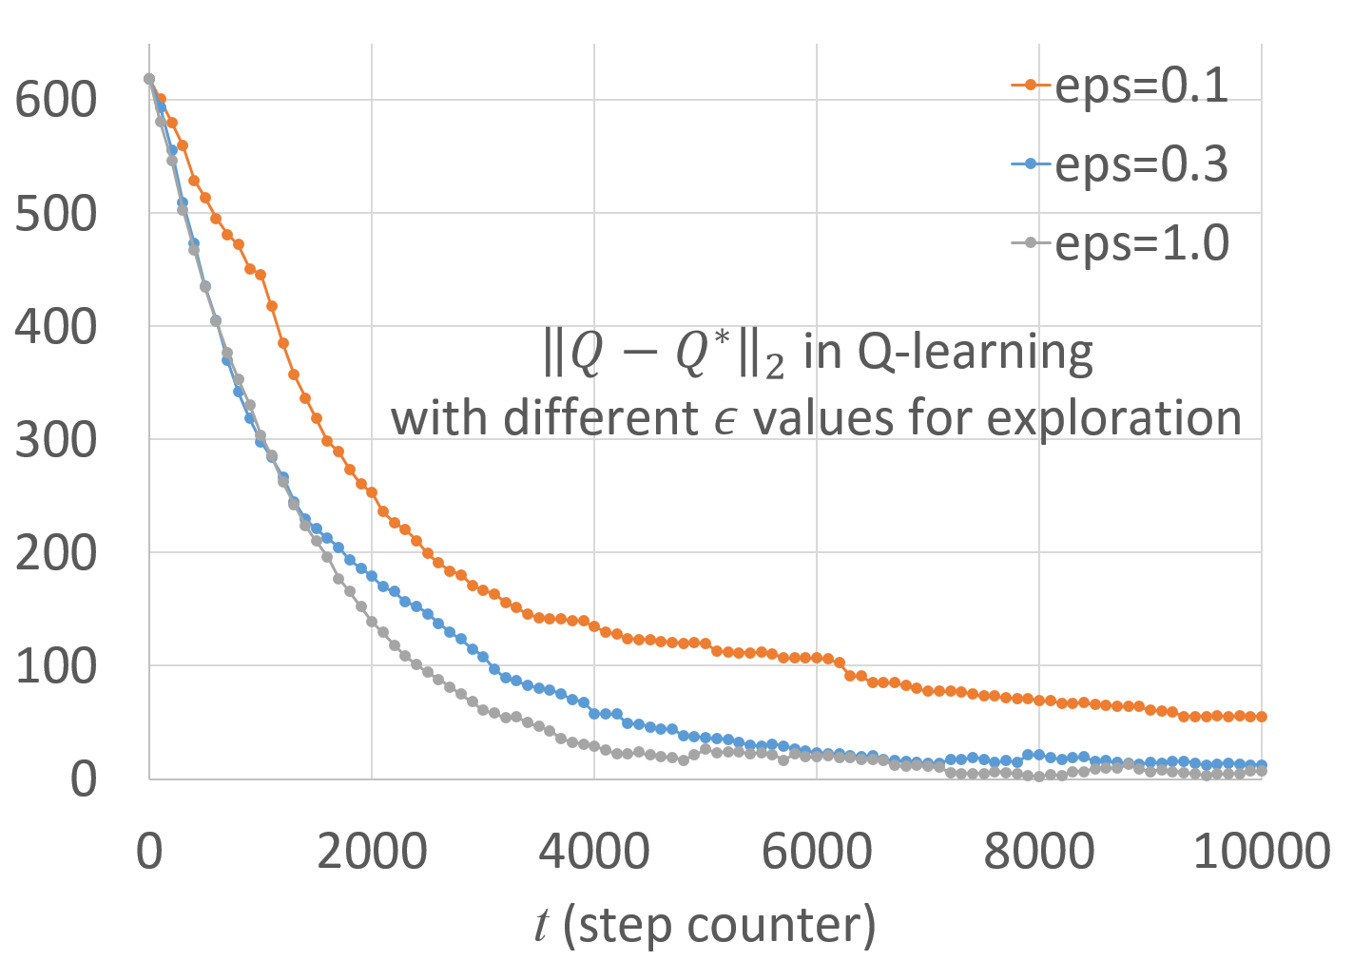
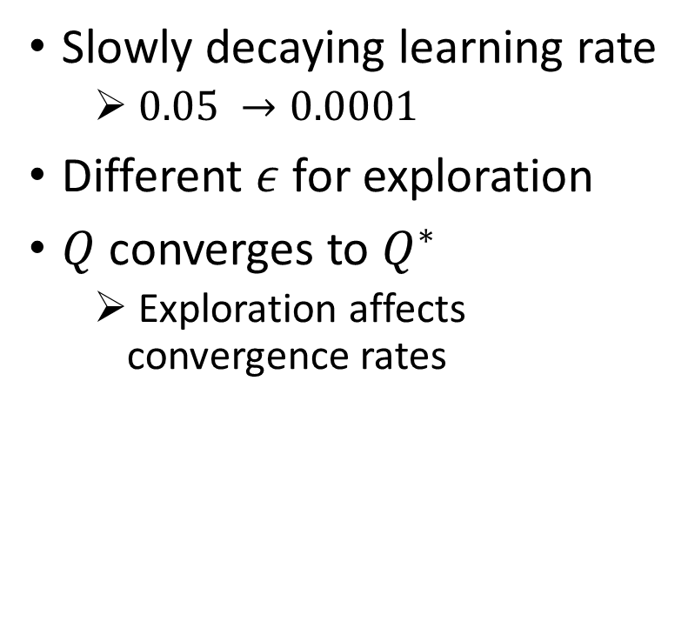
Q-learning in mail campaign example
Slowly decaying learning rate
$0.05 →0.0001$
Different $ε$ for exploration
$Q$ converges to $Q^{∗}$
Exploration affects convergence rates

Slide 29
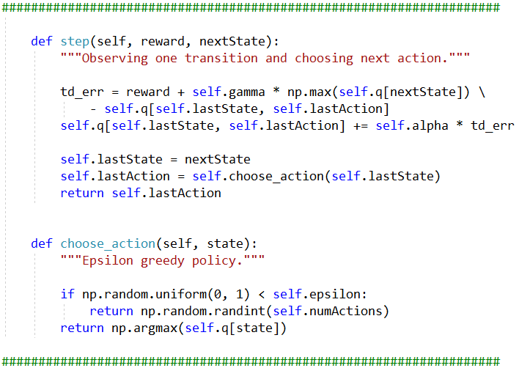
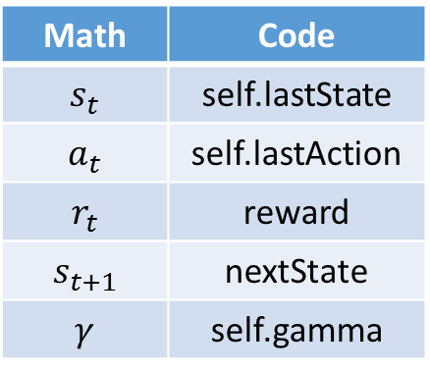
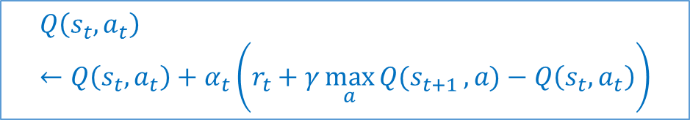
A Python implementation
Math | Code
$$s_{t}$$ | self.lastState
$$a_{t}$$ | self.lastAction
$$r_{t}$$ | reward
$$s_{t+1}$$ | nextState
$$γ$$ | self.gamma
$$Q\left(s_{t},a_{t}\right)←Q\left(s_{t},a_{t}\right)+α_{t}\left(r_{t}+γ\max_{a}{Q(s_{t+1}},a)−Q\left(s_{t},a_{t}\right)\right)$$

Slide 30
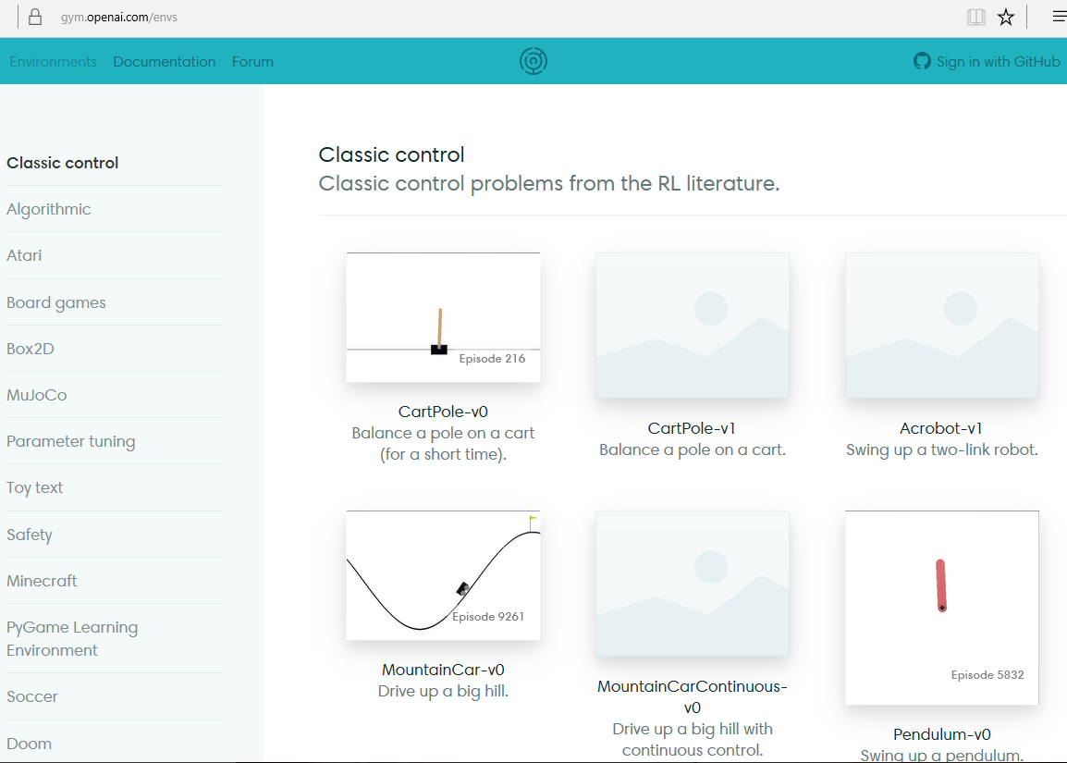
OpenAI Gym
https://gym.openai.com/envs

Slide 31
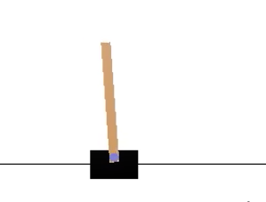



Demo: CartPole
State = $\left(x,\dot{x},y,\dot{y}\right)$
Action = {left, right}
Reward +1 per step
Terminates if $x$ reaches left/right ends, or $\left|y\right|>{15}^{∘}$
Discretize each state dimension into 5 buckets
NumStates $=5×5×5×5=625$
$ε$ gradually decreases from $1$ to $0.01$
$$y$$
$$x$$
Cart Pole demo: https://gym.openai.com/envs/CartPole-v0

Slide 32
Q-learning in Cart Pole

Slide 33
Agenda
What is reinforcement learning
Distinctions from supervised learning
Examples
Basic solutions
Overview
Value iteration and Q-learning
Approximative Methods
Function approximation (Deep-Q Networks)
Policy gradient

Slide 34

Function approximation in RL
Tabular/exact representations do not scale well to large problems
Approximation allows generalization (from seen states to unseen ones)
Improve learning speed
Improve computation speed
Popular choices: linear approximation, kernel methods, decision trees, neural nets, …
Deep RL $=$ RL powered by deep-learning models

Slide 35


Q-learning with function approximation (FA)
Recall tabular Q-learning:
$$Q\left(s_{t},a_{t}\right)←Q\left(s_{t},a_{t}\right)+α_{t}⋅\left(r_{t}+γ\max_{a^{′}}{Q\left(s_{t+1},a′\right)}−Q\left(s_{t},a_{t}\right)\right)$$
Q-learning with FA:
$$Q\left(s,a\right)≔Q\left(s,a;θ\right) θ←θ+α_{t}{⋅δ}_{t}⋅∇_{θ}Q\left(s_{t},a_{t};θ\right)$$
Linear special case:
$$Q\left(s,a\right)≔θ⋅φ\left(s,a\right) θ←θ+α_{t}⋅δ_{t}⋅φ\left(s,a\right)$$
May use back-propagation to compute $∇_{θ}Q$ in neural networks
But, no convergence guarantee in general; extra care is needed.
denoted $δ_{t}$

Slide 36

Practical improvement #1: Two-Q implementation
Bootstrapping in Q-learning with function approximation
Basic Q-learning updates $θ$ using a target computed from $θ$ itself
$θ←θ+α_{t}⋅\left(r_{t}+γ\max_{a^{′}}{Q\left(s_{t+1},a^{′};θ\right)}−Q\left(s_{t},a_{t};θ\right)\right)⋅∇_{θ}Q\left(s_{t},a_{t};θ\right)$
Risk: non-convergence (or even divergence)
(Often) more stable implementation:
Use a second Q-function parameterized by $θ_{\text{target}}$ to compute target value
$$θ←θ+α_{t}⋅\left(r_{t}+γ\max_{a^{′}}{Q\left(s_{t+1},a^{′};θ_{\text{target}}\right)}−Q\left(s_{t},a_{t};θ\right)\right)⋅∇_{θ}Q\left(s_{t},a_{t};θ\right)$$
Replace $θ_{\text{target}}$ by $θ$ once in a while

Slide 37

Practical improvement #2: Experience Replay (ER)
Basic Q-learning uses each sample $\left(s_{t}, a_{t}, r_{t}, s_{t+1}\right)$ only once
Less efficient use of samples
Less stable Q-function updates
Experience replay:
Store a subset of observed samples
“Replay”: periodically go through these samples to do Q-learning updates
Similar to multi-pass training when using SGD in supervised learning

Slide 38

Deep Q-learning: Pseudocode
Input: $ε$, $\left\{α_{t}\right\}$
Initialize two Q-networks: $Q$ and $Q_{target}$
For $t=1,2,3,…$
$a_{t}←ε$-greedy${(s}_{t})$
Take action $a_{t}$, observe reward $r_{t}$ and next-state $s_{t+1}$
Store $\left(s_{t},a_{t},r_{t},s_{t+1}\right)$ to ER buffer $M$
(Once in a while) Run ER to update $Q$ (using $Q_{target}$ and $M$)
(Once in a while) $Q_{target}←Q$
Notes:
Q-learning is one of the value-function-based methods, which first learn the value function, and then use it to derive a policy. The second step, policy derivation, is often easy, involving taking a max over all actions in the current state --- see the note in the last line of the slide.

Slide 39


Deep Q-learning implementation
Note: the last layer should not have a squashing function, as
the network is expected to output $Q$-values (like regression).
A few algorithms implemented and included in CNTK release; thanks to Yi Mao and Chong Wang for help in code development

Slide 40


Slide 41

$$θ← θ+α_{t}⋅\left(r_{t}+γ\max_{a^{′}}{Q\left(s_{t+1},a^{′};θ_{\text{target}}\right)}−Q\left(s_{t},a_{t};θ\right)\right)⋅∇_{θ}Q\left(s_{t},a_{t};θ\right)$$

Slide 42
Deep Q-learning in Cart Pole

Slide 43








DQL variants
DQN
Dueling DQN
Etc…
$$Q\left(s,a\right)$$
Basic DQN
state $s$
$$V\left(s\right)=\frac{Q\left(s,1\right)+⋯Q\left(s,K\right)}{K}$$
$$Q\left(s,a\right)$$
Dueling DQN
state $s$
$$A\left(s,a\right)=Q\left(s,a\right)−V\left(s\right)$$

Slide 44
Policy Search Methods
Value-function methods are indirect in two ways
Optimize VF which then (hopefully) leads to a good policy
More accurate VFs do not necessarily result in better policies
Policy search methods directly optimize a parameterized policy
By stochastic gradient descent, genetic algorithms, …
Often optimize total reward directly
Traditionally useful in robotics/control problems
Gaining increasing interests in other applications (AlphaGo, neural Turing machines, conversational systems, …)

Slide 45
When (not) to use PS?
No definitive answer, but some rules of thumbs
 | VF | PS
Advanced algorithmic design (exploration and off-policy learning) | Easier | Harder
Learning speed | (Often) faster | (Often) slower
Relation to final reward | Indirect / loose | Direct
Incorporate prior knowledge | (Often) trickier | Easier
Convergence | Not guaranteed | Guaranteed
Large/continuous actions | Harder | Easier
Partially observable environments | Harder | Easier
Global optimum | No | No

Slide 46






Policy Gradient
Policy search by stochastic gradient descent
Need an objective function (analogue to loss function in supervised learning)
Need to estimate its gradient from data (to apply back-propagation)
The objective function (for episodic tasks)
Policy parameter is denoted by $θ$
Example (of $3$ actions):
Average reward collected per episode, by running policy with parameter $θ$
$$J\left(θ\right)=E\left[\sum_{t=1}^{H}{γ^{t−1}r_{t}} | a_{t}∼π\left(⋅ | s_{t};θ\right) \right]$$
$$y\left(1\right)$$
$$π\left(a | s;θ\right)=\frac{\exp\left(y\left(a\right)\right)}{\exp\left(y\left(1\right)\right)+\exp\left(y\left(2\right)\right)+\exp\left(y\left(3\right)\right)}∝\exp\left(y\left(a\right)\right)$$
state
$$θ$$
$$y\left(2\right)$$
$$y\left(3\right)$$

Slide 47




Gradient of $J\left(θ\right)$
$τ=\left(s_{1},a_{1},r_{1},…,s_{H},a_{H}, r_{H}\right)$ : an episode of length $H$
$Traj=\left\{τ\right\}$ : set of all possible episodes of length $H$
$R\left(τ\right)=r_{1}+γr_{2}+⋯+γ^{H−1}r_{H}$ : the total discounted reward collected in $τ$
$$J\left(θ\right)=E\left[\sum_{t=1}^{H}{γ^{t−1}r_{t}}| a_{t}∼π\left(⋅ | s_{t};θ\right)\right]=\sum_{τ∈Traj}{p_{θ}\left(τ\right)R\left(τ\right)}$$
Gradient calculation:
$$∇_{θ}J\left(θ\right)=∇_{θ}\left(\sum_{τ∈Traj}{p_{θ}\left(τ\right)R\left(τ\right)}\right)=\sum_{τ∈Traj}{∇_{θ}p_{θ}\left(τ\right)R\left(τ\right)}$$
$$=\sum_{τ∈Traj}{{p_{θ}\left(τ\right)⋅∇}_{θ}\left(\log{p_{θ}\left(τ\right)}\right)}⋅R\left(τ\right)$$
$$=…=\sum_{τ∈Traj}{p_{θ}\left(τ\right)\left(\sum_{t}{∇_{θ}\log{π_{θ}\left(a_{t} | s_{t}\right)}\sum_{h≥t}{γ^{h−1}r_{h}}}\right)}$$
$$∇\log{f}=\frac{∇f}{f}$$
$$p_{θ}\left(τ\right)=\text{const}\left(θ\right)⋅\prod_{t=1}^{H}{π_{θ}\left(a_{t} | s_{t}\right)}$$
Note: there are many variants to calculate the gradient, for different settings.

Slide 48

REINFORCE [Williams, 92]
Input: $B$ (batch size), $α$ (learning rate), baseline function $b\left(s,h\right)$
Initialize $θ$ (parameters of policy network)
Repeat until convergence
Use current policy network to generate $B$ trajectories $\{τ_{1},τ_{2},…, τ_{B}\}$
Estimate gradient
$$Δθ←\frac{1}{B⋅H}\sum_{i=1}^{B}{\sum_{t=1}^{H}{∇_{θ}\log{π\left(a_{t}^{\left(i\right)} | s_{t}^{\left(i\right)}\right)\left(\sum_{h=t}^{H}{\left(γ^{h−1}r_{h}^{\left(i\right)}−b\left(s,h\right)\right)}\right)}}}$$
Update policy network: $θ←θ+α⋅Δθ$
May be improved by actor-critic algorithms [reference]; also see recent empirical study with A3C.
Notes:
Williams 92 vs. Sutton et al. 99?

Slide 49
RL algorithms: A simplified overview
 | Model is known (aka “planning”) | Model is unknown (Access to environment/corpus, but not $P$ or $R$)
Value-function based (learn $Q^{∗}$ first, then $π^{∗}$) | Value iteration Policy iteration Linear programming Monte Carlo tree search | Approx. value iteration (Q-learning, Sarsa, …) Approx. policy iteration (LSPI, …) Monte Carlo estimation …
Direct policy search (learn $π^{∗}$ directly) |  | Policy gradient …
Value iteration
Q-learning
Policy gradient
Not covered: model-based RL, actor-critic, exploration , reward shaping, off-policy RL
hierarchical problem solving, transfer/multi-task RL, multi-agent RL, …
Representation
Tabular
State abstraction/aggregation
Linear approximation
Nonlinear approximation
“deep RL”

Slide 50
Survivors may do the lab…

